Slide 1
Functional Harness
Exercise:
- Retrospective

Slide 2
FUNCTIONAL is EASY

Slide 3
Functional Code
1. All inputs
2. deterministic
3. All results

Slide 4
Non-Functional Code
(No Inputs)
get inputs from global state;
use random, dates, or other varying data;
write results to global state;
(No Return)

Slide 5
NON-FUNCTIONAL is HARD

Slide 6
Reduce To Functional
Functional?
Yes
Easy
No
Hard
Reduce to
Functional
Notes:
If it’s hard to test, change it so it’s easy
The solution to testing hard code isn’t to get good at testing hard code
The solution is to make the code itself easy to test
This whole set of exercises is showing different tricks to make code look like it’s functional, returning info for testing

Slide 7
Changing Output

Slide 8
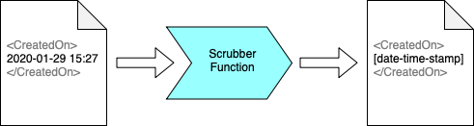
Scrubbers
Notes:
Scrubbers are an approval tests concept for converting unstable output to stable output, without changing the code being tests
Here, we are changing a date and time to some fixed text

Slide 9
std::string scrub(const std::string& input)
Scrubbers::createRegexScrubber(R"(\d+)", "[number]")
Notes:
Top line shows the signature for a scrubber
Creating this for regexes is hard
So we have createRegexScrubber as a convenience function, to do the work for you

Slide 10
Changing Code

Slide 11
The Hard Parts
Non-deterministic code
Third-party code
Non-compiling code
Hard-to-set-up code
Code I don’t have a licence to run
Slow-running code
Code that needs other services, applications or hardware Anything else that annoys you
Notes:
What do we mean by Hard Parts
Big pattern: anything that annoys you

Slide 12
The Peel
Notes:
The hard-part was the time
Separate one method in to two
Ignore the first method – just calls now()

Slide 13
The Peel
Goal: Separate the method in to 2 methods
Identify that the hard part is all at the beginning (or end)
You may need to refactor for this
Refactor to extract all else into a separate method
You now have two methods
The original method: small, simple, hard-to-test
Your new method: holds business logic, easy-to-test
Test the easy thing; ignore the hard thing

Slide 14
The Slice
return sample
Notes:
The line in red calls out to something that is not controllable in tests, or cannot easily be set up
And it is in the middle of the code we are testing, so Peel doesn’t help
So we insert a fake thing, that pretends to do the difficult step

Slide 15
int getID()
{
srand( time(0) );
return (rand() % 10 + 1);
}
Notes:
Original code
Bit in red is hurting us

Slide 16
1. #ifdef TESTING
int getID()
{
#ifdef TESTING
srand(500);
#else
srand( time(0) );
#endif
return (rand() % 10 + 1);
}
Notes:
Pro: Edit is localised
Pro: Convenient Intermediate step on way to better code
Con: Requires code to be built twice – once for prod and once for testing
Con: Risky – hack may get built in to production code

Slide 17
2.
passIn(seed)
int getID()
{
time_t seed = time(0);
return getID(seed);
}
int getID(time_t seed)
{
srand(seed);
return (rand() % 10 + 1);
}
Test This
Notes:
Pro: Easier to understand
Pro: Less global state
Pro: Standard refactoring
Con: Tests don’t show intention, only results, as seed does not correlate with result

Slide 18
3.
passIn(rand)
int getID()
{
srand( time(0) );
int random = rand();
return getID(random);
}
int getID(int random)
{
return (random % 10 + 1);
}
Test This
Notes:
Pro: Easier to understand
Pro: Less global state
Pro: Standard refactoring
Pro: Tests show intention, as random does correlate with result
Con: Can be harder to understand the code enough to make this cut

Slide 19
Side Effects
Demo!

Slide 20
RETRO
💬

Slide 21
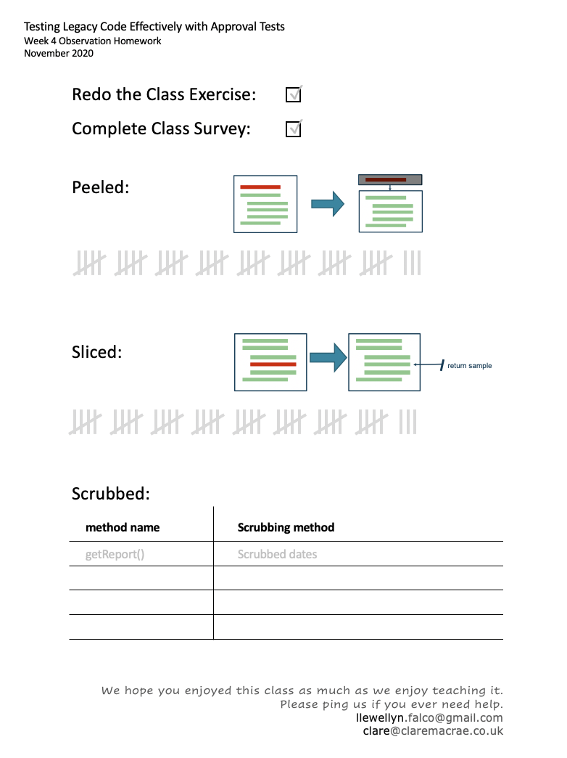
Homework
Redo the exercise, solo
Take notes on peel, slice, scrubbers
Complete Survey
Notes:
Difficult: Anything you saw that was “Oh that would be hard to test”. No action required
I tried: “Any time you tried to test something, make a note”. Action, but optional
Problems: “I tried to test this, and then couldn’t figure out how to solve it”. Action, but optional

Slide 22
Further Resources
bit.ly/TestingCpp

Slide 23


Thanks, please keep in touch…
@ LlewellynFalco
LlewellynFalco
@ ClareMacraeUK
ClareMacrae

Slide 24
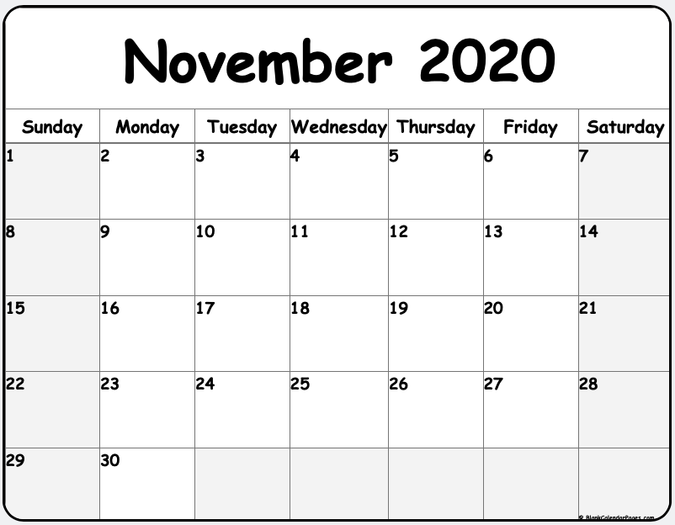
Future Training
4 x 2-hour sessions
+ Optional 2-hour consult
bit.ly/LegacyCppNov2020
THANKS!
Please connect on LinkedIn and Twitter
Notes:
https://blankcalendarpages.com
https://blankcalendarpages.com/November-2020-calendar
Scroll down for Comic Sans one
Or build custom one

